Slide 1
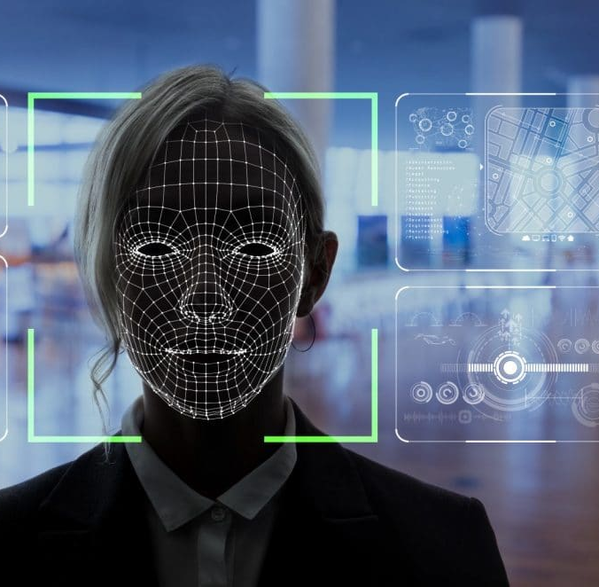
Project F.A.C.E.
(Face Acknowledgement using Computational Elements)
Task Phase Project

Slide 2


Content
Introduction
Key Objectives
Methodology
References
Team Details

Slide 3

Introduction:
Tracking attendance of large workstation or an education system is a tedious task which consumes a lot of time and effort. This can be minimized by automating it i.e., by having the information such as their name and pictures of people that we need to recognize. By linking this information to OpenCV we can recognize and store their attendance without much user interface.
The attendance could be stored in an excel sheet and the percent could be calculated. If the attendance is less than the requirement an alert mail could be send to the student informing him about his current status regarding his attendance.

Slide 4

Key Objectives:
Face Recognition(FR):
To develop a face recognition system which:
Detects faces and matches it with the existing data base.
Makes a green color rectangle around the face if it matches with the database else makes a red rectangle.
Excel Sheet (Attendance sheet):
To link python with excel and make a sheet which:
Marks attendance as soon as the face is recognized and calculates the percentage.
Email Sending Bot:
To send emails using python:
It iterates the attendees in the sheet and send an alert mail to the attendee having attendance less than 75%.

Slide 5

Methodology:
Face Recognition:
We capture a frame using OpenCV module and convert the frame from BGR to RGB channel and further change it to GRAY channel. Then the module reads the complete image pixel wise and marks arrows on it pointing from light to dark region. The obtained image is called HOG (Histogram of Gradient) which eliminates the issue of matching the image with the template image in varying brightness.
As the image we get have different orientation of face, it appears to the computer as completely different image. To resolve this problem, we use an algorithm called 'Face estimation landmark', which basically find 68 specific points that is present on every face. This algorithm uses machine learning to find these points and rotates the scale of these specific points and tries to centre the eyes and the mouth in the same position as the image in database. It then searches through the database and tries to match with every image. The image which has the closest resemblance and measurements is then given as our match. So, algorithm returns the information from the database of the closest match keeps checking and updating the attendance for a specified period.

Slide 6
Excel Sheet:
Once the face is recognized attendance is marked under respective columns denoting dates which is done by using date and time module. We enter data in excel sheet using a library called openpyxl library.
We performed calculations like taking out attendance percentage in python and inserted the values in excel sheet. We also iterated through the column containing percentage and if the attendance was found to be less than 75% an alert mail will be sent to the student informing him about the same.
Email Sending Bot:
If the attendance of a student is found to be less than 75% an alert mail would be sent to his mail ID. In this first we created a sendmail function which takes arguments like sender’s mail ID, receiver’s mail ID, subject and mail content.
Then we apply a condition and call the function. When the condition is satisfied the function sends a mail to the recipient.
Methodology:

Slide 7

References:
https://youtu.be/mYVS7QjNjvg
https://youtu.be/7YS6YDQKFh0
https://youtu.be/4AMsBrkkH00

Slide 8

Team Details:
Pendyala Gnana Sai
Anirudh Agrawal
Rishabh Singh

